Slide 1

CSC364-Software Engineering Week-1 Lecture-12 Semester-# Fall 2018
Prepared by:
M. Sajid Farooq

Slide 2
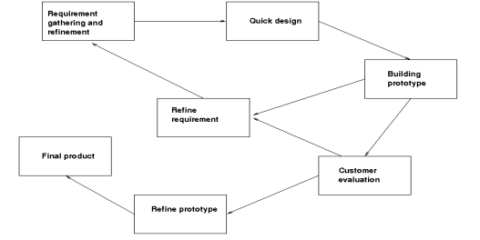
Prototyping
Example: Text Editor

Slide 3
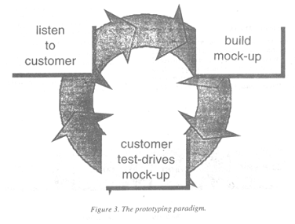
Prototyping

Slide 4
Prototyping
Strengths
The designer demonstrates the prototype, the user evaluates for problems and suggests improvements.
This loop continues until the user is satisfied
Users give corrective feedback
When the user is satisfied, the prototype code is brought up to the standards needed for a final product.
Developers learn from customers
A more accurate end product
Unexpected requirements accommodated
Steady, visible signs of progress produced
Interaction with the prototype stimulates awareness of additional needed functionality

Slide 5
Prototyping
Deficiencies
The customer may want the prototype delivered.
Customer may not aware of complete product.
Overall maintainability may be overlooked
Developer may makes implementation compromise

Slide 6
Prototyping
When to use this Model
Requirements are unstable or have to be clarified
As the requirements clarification stage of a waterfall model
Develop user interfaces
Short-lived demonstrations

Slide 7
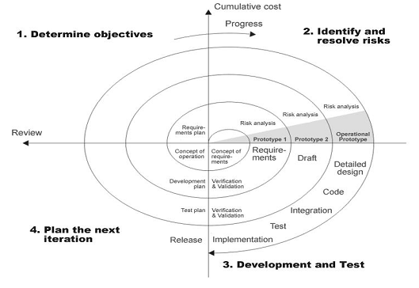
Spiral Model

Slide 8
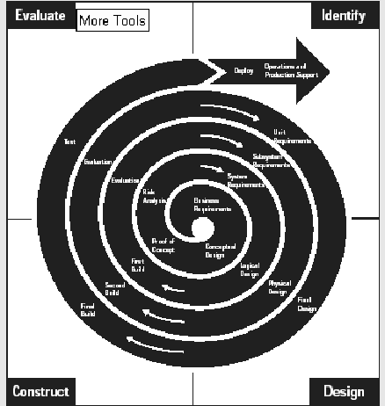
Spiral Model

Slide 9
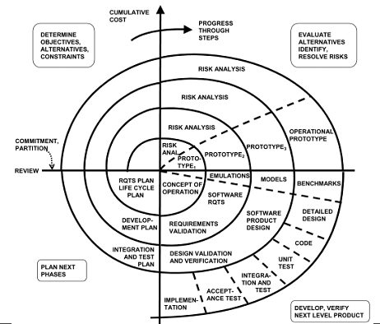
Spiral Model

Slide 10
Spiral Model
Strengths
Software is developed in evolutionary releases
The model is divided into the set of framework (planning, Risk analysis, construction, deployment, communication)
Iterative nature of prototyping with the control and systematic nature of waterfall model.
Critical high-risk functions are developed first
Users can be closely tied to all lifecycle steps
Early and frequent feedback from users

Slide 11
Spiral Model
Deficiencies
Time spent for evaluating risks too large for small or low-risk projects
Time spent in planning, resetting objectives, doing risk analysis and prototyping may be excessive
The model is complex
Risk assessment expertise is required
Spiral may continue indefinitely
Developers must be reassigned during non development phase activities

Slide 12
Spiral Model
When to use this Model
When creation of a prototype is appropriate
When costs and risk evaluation is important
For medium to high-risk projects
Users are unsure of their needs
Requirements are complex
Significant changes are expected (research and exploration)

Slide 13
Recommended here
See
The Concurrent Development Model
Formal methods
You may be asked in a quiz.

Slide 14
Further Reading
Do read the models from internet and different literatures.
Some documents have been uploaded on the group to be read against this lecture.
Do read them, the earliest.

Slide 15
Conclusion
What ever be the Model, you must know the right situation for selecting a particular model. More you should be aware of the associated advantages and disadvantages.

Slide 16
The discipline of SE
SE and its relation to other fields.
SE
OOSE
SPM
SQM
SEP
SQC
SQA
OOM

Slide 17
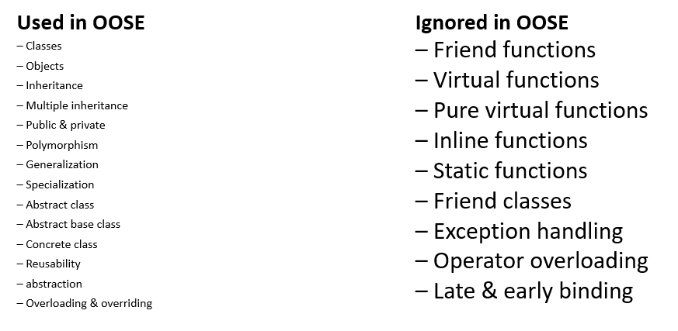
Concepts of OOP

Slide 18
SDLCs
How many of you know any SDLC ?
What are they ?

Slide 19
SDLCs
Water Fall Model
The Incremental Model
The RAD Model
Prototyping
The Spiral Model

Slide 20
SDLCs
The Concurrent Development Model
Component based Development
The Formal Methods
Agile Methods
xP (Extreme Programming)
SCRUM

Slide 21
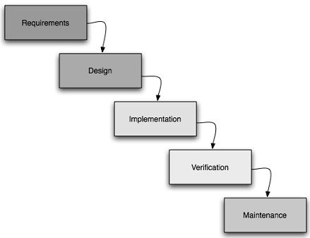
SDLCs - Water Fall Model
The waterfall model is a sequential software development model (a process for the creation of software) in which development is seen as flowing steadily downwards (like a waterfall) through the phases of requirements analysis, design, implementation, testing (validation), integration, and maintenance.

Slide 22
SDLCs
Different phases yields different things:
Work Products
Deliverables
IEEE 1074 Software Product Development Life Cycle Model
Show it.
IEEE Std 830-1998 Recommended Practice for Software Requirements Specifications
Show it.

